Slide 1
PEGASOS
Primal Efficient sub-GrAdient SOlver for SVM

Slide 2
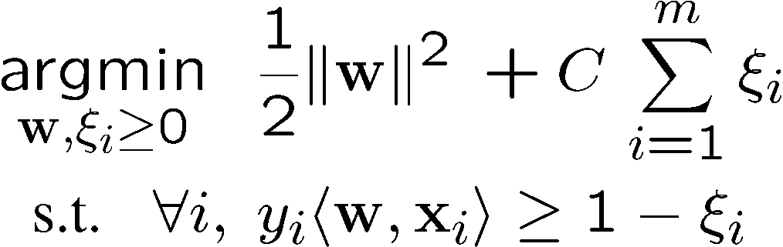

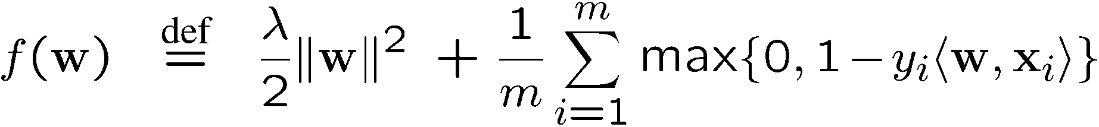
Support Vector Machines
QP form:
More “natural” form:
Regularization term
Empirical loss

Slide 3
Previous Work
Dual-based methods
  Interior Point methods
    Memory: m², time: m³ log(log(1/ε))
  Decomposition methods
    Memory: m, Time: super-linear in m
Online learning & Stochastic Gradient
  Memory: O(1), Time: 1/ε² (linear kernel)
  Memory: 1/ε², Time: 1/ε⁴ (non-linear kernel)
  Typically, online learning algorithms do not converge to the optimal solution of SVM
Better rates for finite dimensional instances (Murata, Bottou)

Slide 4
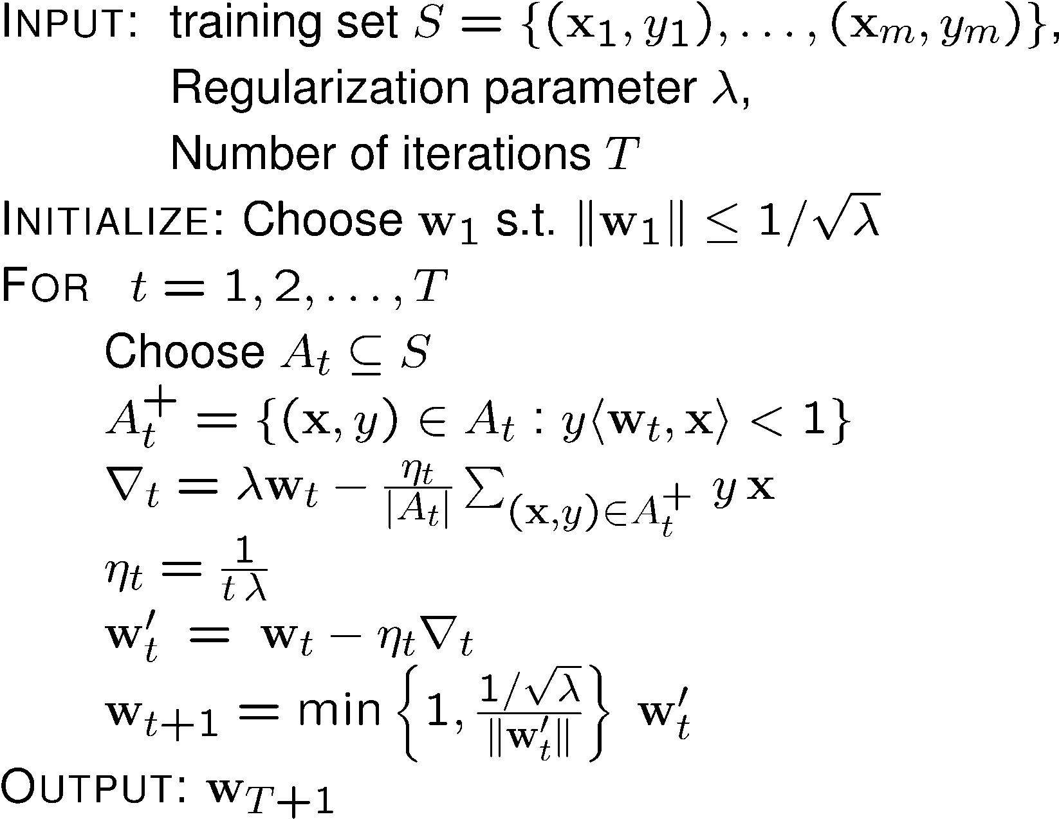
PEGASOS
A_t = S
Subgradient method
|A_t| = 1
Stochastic gradient
Subgradient
Projection

Slide 5
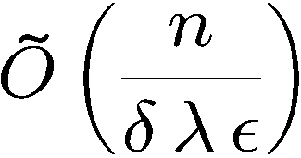
Run-Time of Pegasos
Choosing |A_{t}|=1 and a linear kernel over R^{n}
➔ Run-time required for Pegasos to find ε accurate solution w.p. ¸ 1-δ
Run-time does not depend on #examples
Depends on “difficulty” of problem (λ and ε)

Slide 6

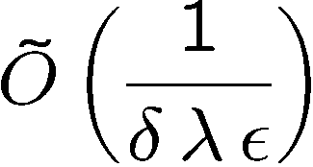
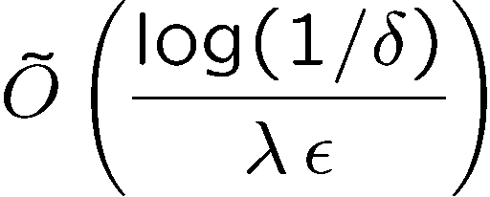
Formal Properties
Definition: w is ε accurate if
Theorem 1: Pegasos finds ε accurate solution w.p. ¸ 1-δ after at most
iterations.
Theorem 2: Pegasos finds log(1/δ) solutions s.t. w.p. ¸ 1-δ, at least one of them is ε accurate after iterations

Slide 7
Experiments
3 datasets (provided by Joachims)
  Reuters CCAT (800K examples, 47k features)
  Physics ArXiv (62k examples, 100k features)
  Covertype (581k examples, 54 features)
4 competing algorithms
  SVM-light (Joachims)
  SVM-Perf (Joachims’06)
  Norma (Kivinen, Smola, Williamson ’02)
  Zhang’04 (stochastic gradient descent)
Source-Code available online

Slide 8
Training Time (in seconds)
 | Pegasos | SVM-Perf | SVM-Light
Reuters | 2 | 77 | 20,075
Covertype | 6 | 85 | 25,514
Astro-Physics | 2 | 5 | 80

Slide 9
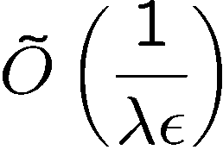
I want my kernels !
Pegasos can seamlessly be adapted to employ non-linear kernels while working solely on the primal objective function
No need to switch to the dual problem
Number of support vectors is bounded by

Slide 10
Discussion
Pegasos: Simple & Efficient solver for SVM

